Slide 1
DATA ANALYTICS PROJECT
DATA ANALYTIC & VISUALIZATION (1IT508)
HEART DISEASE
From raw records to a clear Power BI dashboard
ENROLLMENT NO.: 240840116083
240840116084
240840116087
240840116128
240840116131
PROBLEM STATEMENT
Raw heart-health data may contain repeated records and is harder to interpret without cleaning and visual analysis.
01 / 07

Slide 2
01 • RAW DATA
Observation of the raw dataset
Source file: 16_ heart.csv • Initial inspection before cleaning
ROWS
COLUMNS
DUPLICATE ROWS
MISSING VALUES
1,025
14
723
0
Columns available
Main issue found
age • sex • cp • trestbps • chol • fbs • restecg • thalach • exang • oldpeak • slope • ca • thal • target
723 completely duplicated rows were detected (70.5% of the raw file).
The target column is the outcome label; confirm its coding with the dataset documentation.
No missing values were detected in the raw file. Duplicate records need review before removal.
02 / 07

Slide 3
02 • DATA PREPARATION
Data cleaning process
Cleaning was performed in Python using Pandas, then exported as cleaned_heart.csv.
01
Load CSV
Read the raw file into a Pandas DataFrame.
02
Inspect
Check shape, column types, missing values and duplicates.
03
Remove exact duplicates
Keep one copy of each fully identical row.
04
Validate numeric fields
Check age and oldpeak numeric types; inspect for conversion errors.
05
Export
Save the cleaned result to a new CSV, preserving the raw source.
Important: removing duplicates assumes repeated rows are unwanted copies. Verify this decision for any medical or patient-level analysis.
03 / 07

Slide 4
03 • CLEANED DATA
Solution: final clean dataset
Comparison of raw and cleaned files after exact duplicate removal
Metric | Raw data | Clean data
Rows | 1,025 | 302
Columns | 14 | 14
Exact duplicate rows | 723 | 0
Final file
cleaned_heart.csv
302 rows × 14 columns
0 missing values • 0 duplicate rows
What improved?
Removed 723 exact duplicate rows (1,025 → 302). All 14 columns were retained. No missing values were present in either file.
No additional rows were dropped for outliers; unusual values should be reviewed with domain context rather than deleted automatically.
04 / 07

Slide 5
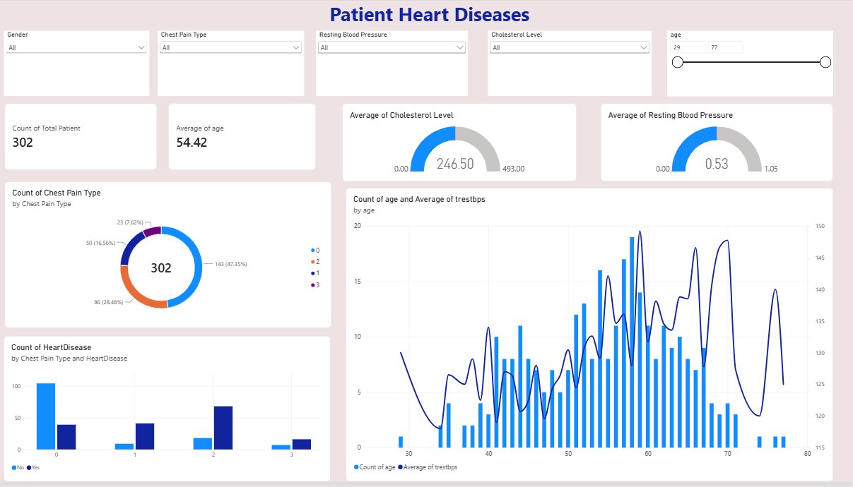
04 • VISUAL ANALYTICS
Visualizations of the cleaned dataset
A dashboard-style overview created from the cleaned heart dataset
05 / 07

Slide 6
05 • FINDINGS
Observations from the dashboard
Descriptive findings from the 302 unique records (not medical conclusions)
DISEASE PATIENTS
164 (54.3%)
NO DISEASE
138 (45.7%)
AVERAGE AGE
54.4 years
AVERAGE CHOLESTEROL
246.5
Key observations
• Mean resting blood pressure: 131.6; mean maximum heart rate: 149.6.
• Outcome groups: 164 records are target=1 and 138 are target=0 (assuming documented coding is 1=present, 0=absent).
• Chest-pain codes differ in how many disease-positive and disease-negative records they contain; interpret codes using the dataset documentation.
The target column is an encoded outcome. Results describe this dataset only and should not be used for diagnosis.
06 / 07

Slide 7
06 • NEXT STEPS
Recommendations and suggestions
Practical improvements for a reliable and useful Power BI report
01
Validate duplicate policy
02
Verify category definitions
Confirm whether identical rows are repeated copies or legitimate repeated observations before excluding them.
Document the meaning of sex, chest-pain, restecg, thal and target codes.
03
Review unusual values
04
Improve dashboard usability
Investigate high cholesterol or other unusual measurements; do not remove outliers without justification.
Use dropdown slicers for categories, range sliders for numeric fields, clear titles and consistent colors.
05
Add useful comparisons
06
Refresh and document
Show disease-status counts by age group and chest-pain category, plus average cholesterol and blood pressure.
Keep raw and cleaned files separate, record cleaning steps, and refresh the report when new data arrives.
CONCLUSION • Cleaning improves consistency; visualization makes patterns easier to explore.
07 / 07

